Slide 1
SWE Presentation
Team Fantastic 4

Slide 2






THE TEAM
Ang Kai Jun
Ivan Loke Zhi Hao
Chay Hui Xiang
Liu Liwen
Ng Li Lin Evonne
Chang Dao Zheng

Slide 3

TwoTyred Application

Slide 4



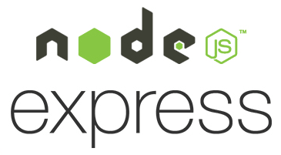


TECH STACK
FRONTEND
BACKEND
DATABASE

Slide 5



Datasets used

Slide 6
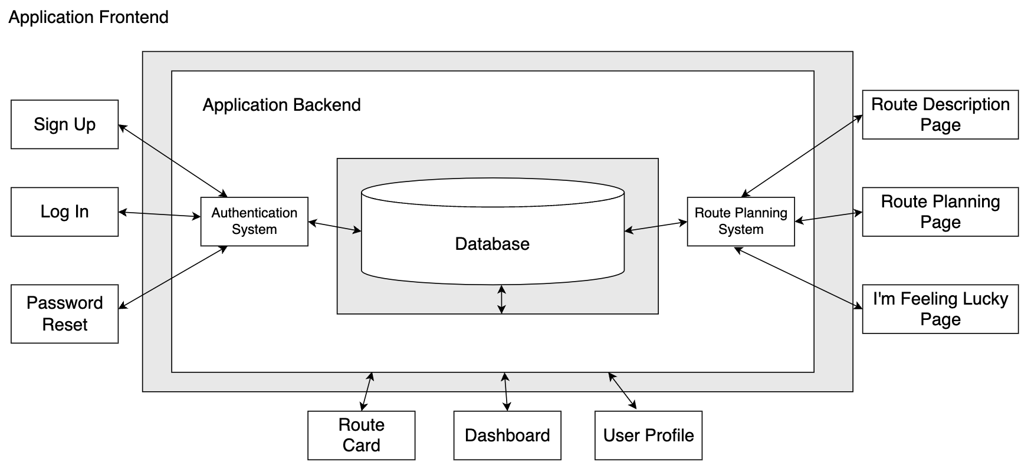
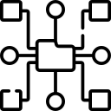

System Architecture Diagram
Features
High level structure of
web application
Loose coupling, high cohesion:
Classes are split into different
"layers" and "layers"
can only communicate with neighbouring "layers"
6
Notes:
For our system architecture diagram, it is the high level structure of our web application. And if you examine our class diagram, you can see that our architecture diagram is very similar to it, just that it is more macro. So allow me to take you through the different parts of the diagram. In designing this architecture, we used the loose coupling and high cohesion principle. You can see that our diagram has 3 different layers, namely application frontend which contains the boundary classes, application backend which contains the app logic and database which contains all the data of the users and routes. It adopts loose coupling as each layer can only communicate with the adjacent layer. For example, app frontend cannot communicate with database. This adds security to our app as well as allows for better scaling of it.

Slide 7
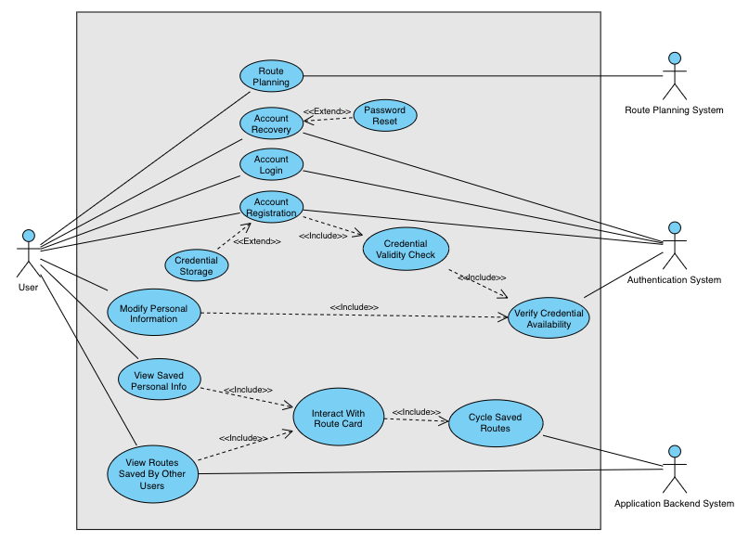
Use Case Diagram
Notes:
For this presentation, we will be presenting on 2 uses cases. Namely: route planning and Interact with Route Card

Slide 8
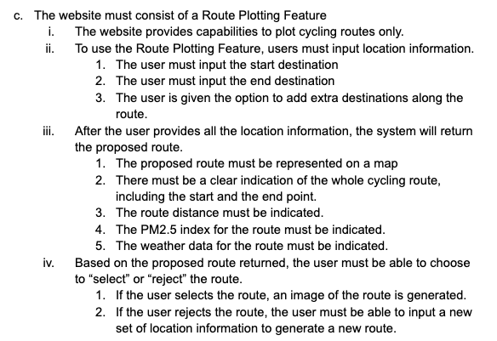
Use Case: Route Planning
Functional Requirements Traceability
Main Points:
User can add extra destinations
The weather and route information will be shown
User can choose to select or reject the route

Slide 9
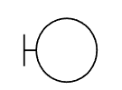


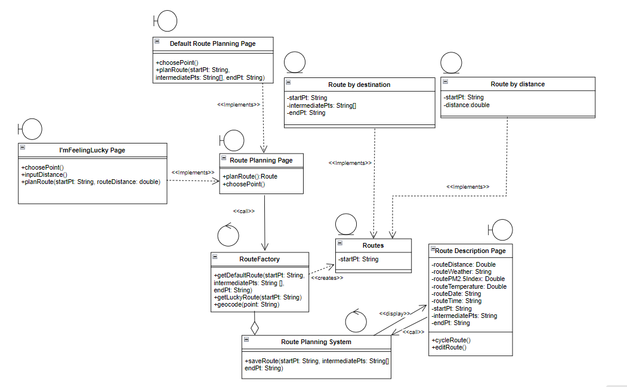
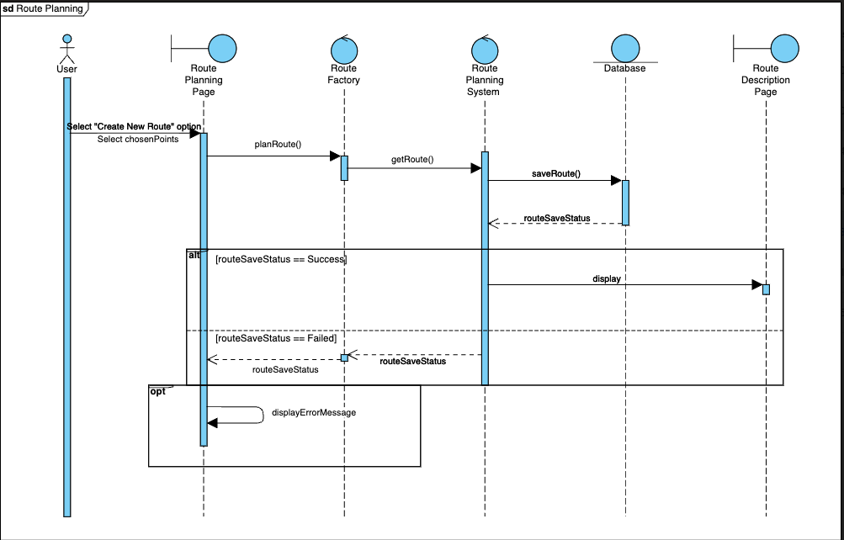
Use Case: Route Planning
Boundary Classes
Control Classes
Entity Classes
Route planning pages
Route description page
Route planning system
RouteFactory
Route by Destination
Route by Distance
Routes
Notes:
On the left is the relevant class diagram for our Route planning function. The boundary class consists of the route planning page where the user will initiate the route planning function and route description page where the route will be displayed after generation. There is also the Route planning system which serves as the control class that calls the onemap API and generates the route based on User inputs. Lastly we have the Entity classes of route by destination and route by distance which are being used by the route factory to generate either of these two types of routes . On the right is the sequence diagram for this use case. We can see that the user will first select “Create New Route” on the route planning page and this will in turn will call the planRoute method based on the chosen points for the user. In the event that the route was successfully created, it will then be stored into the database and upon successfully saving in the database, will show the completed route with its route description on the route description page.

Slide 10
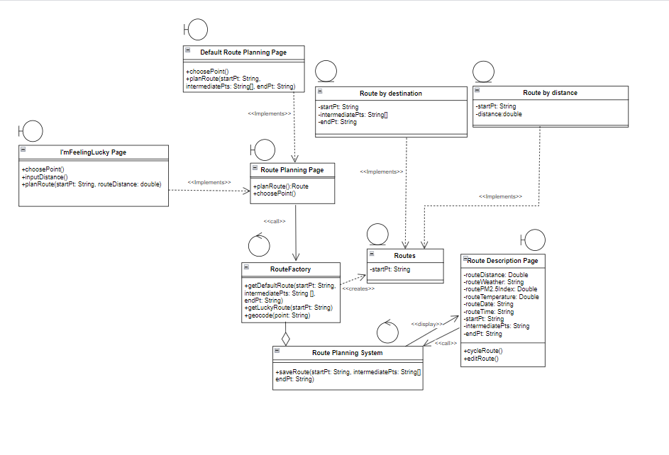

Design Patterns for Route Planning Function
Factory Design + Strategy Design
Generate Class only on Runtime (Dynamic loading)
Increases robustness
and performance
Ease in extending or
adding new subclasses
Notes:
One of the designs we have chosen for this use case was to use strategy together with factory design to support envisioned further upgrades. While working on the route planning feature, we wanted our app to be more robust and have more options for users to create routes. To enable this, we decide to use the factory design for our Route planning interface to dynamically instantiate classes based on which route planning type was chosen. This works hand in hand with strategy design which encapsulates object creation and makes it easier to add new classes by implementing the same interface. The implementation can be seen on the class diagram at the left where we have a routefactory that can generate a route. This routefactory is an abstract class that can generate either route by destination or route by distance, both of which being entity classes and stored in the database. Thus, depending on the input, only one class will be created.

Slide 11
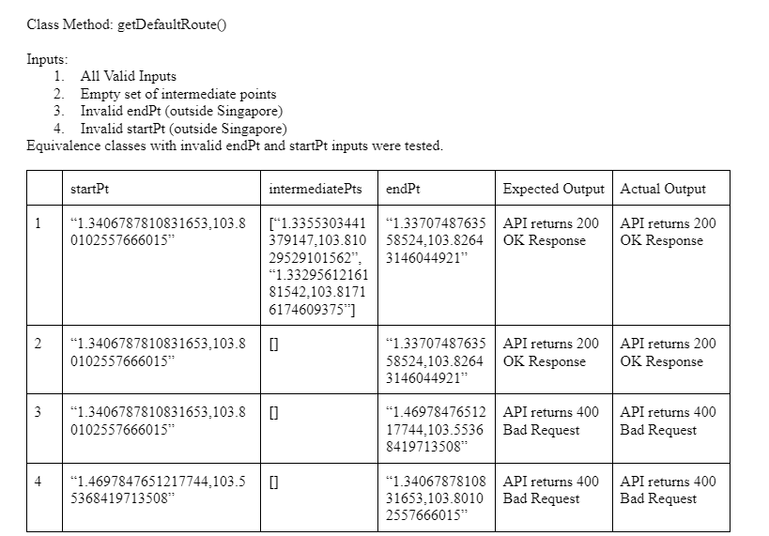
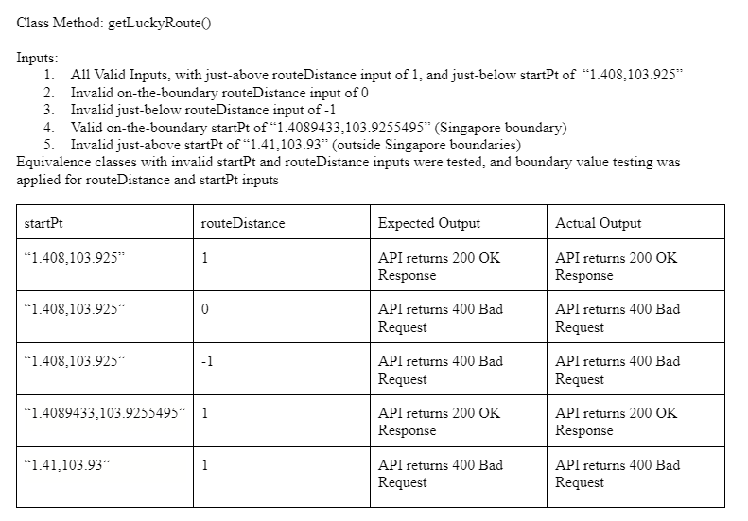
Blackbox Testing for Route Planning Function
Notes:
Black box testing using invalid and valid equivalence classes. We tested the route factory control class using invalid and valid start and end points and we achieved the desired results.

Slide 12
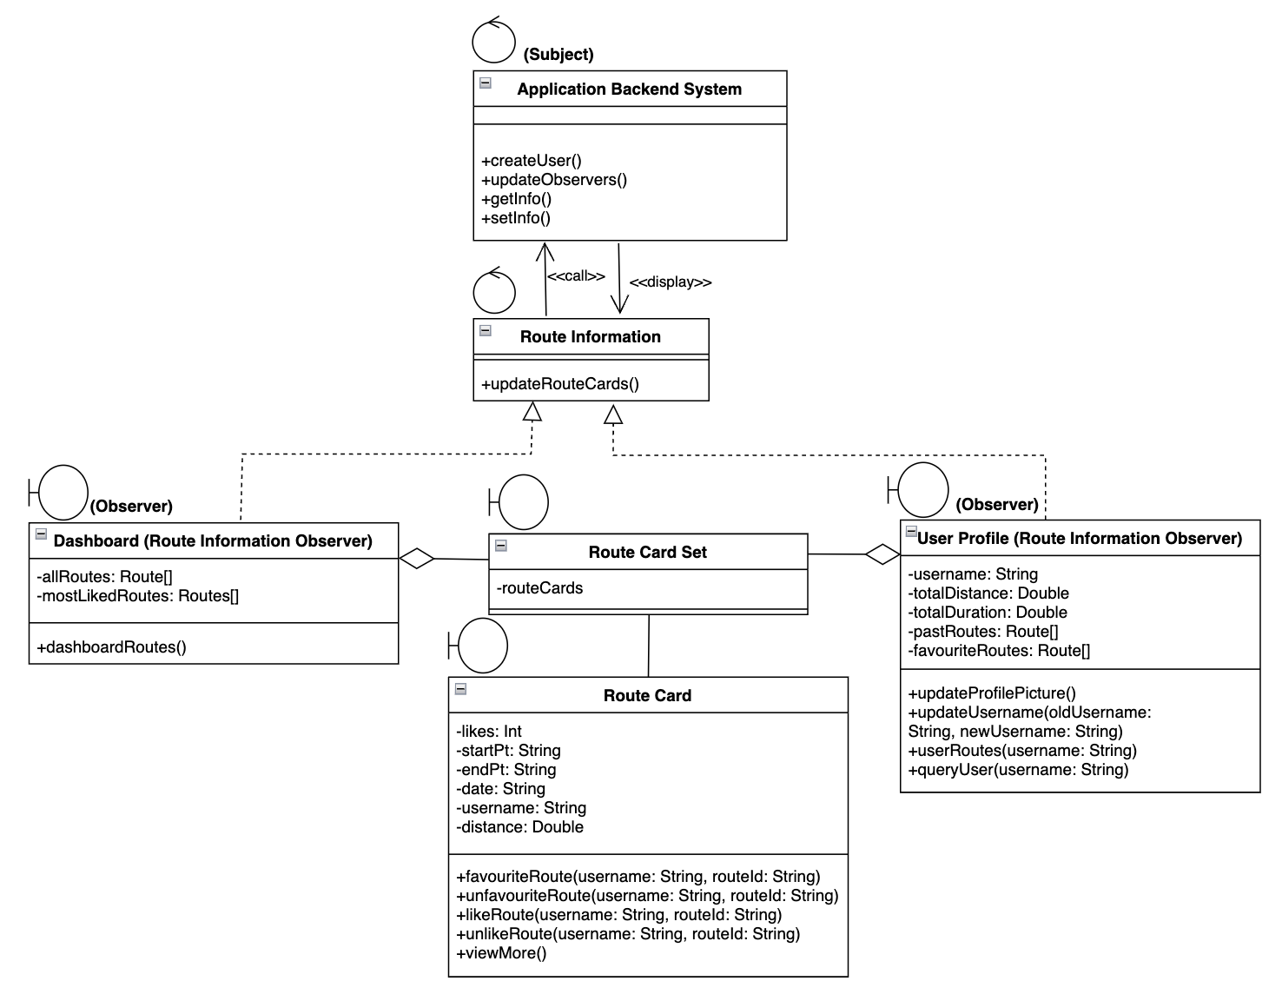
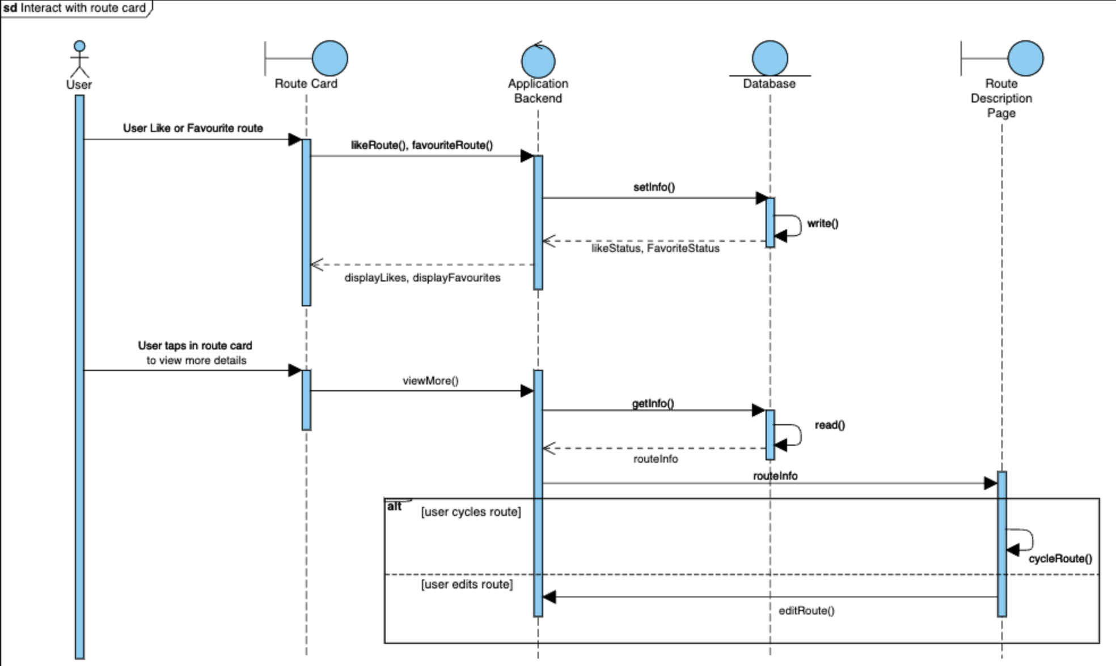
Use Case: Interact with Route Card
Boundary Classes
Control Classes
Route Card Set
Dashboard
User Profile
Application Backend
Route Information
Notes:
Next, let’s take a look at the Interact with Route Card use case
For this use case, there are 3 boundary classes, namely the Route Card Set, the Dashboard, and the User Profile.
The route card set, which encompasses all the route cards. The other 2 are the dashboard and the user profile will comprise of the route card set as seen from the class diagram
There are 2 control classes. The first is the application backend, which is involved in the CRUD functions, and the second is the Route Information Subject, which is used for Observer Pattern which I will elaborate later.
The main crux of this use case lies in the route card. The route card displays the route information such as the startPt, endPt, distance, route and likeCount.
There are 3 main ways to interact with the route card: 1) like/ unlike route, 2) favourite/ unfavourite route, 3) to view more
As seen from the Sequence Diagram, when you click the like button, the likeRoute method will be called, and the backend will increase the likeCount in the database by 1
When you click the favourite button, the favouriteRoute method will be called, and the backend will add the routeId to the array of favouriteRoutes
On the other hand, when the user clicks into the route card to view more details, the backend will retrieve the route information from the database and reflect it on the route description page

Slide 13

Design Patterns for Interact with Route Card
Observer Pattern
Updates many observers
When the subject changes
Loose coupling between
observers and subjects
Notes:
For this use case, our group adopted the Observer Pattern
In this case, the subject is the backend and the observers are the dashboard and the user profile, which both implements the abstract class Route Information
The reason for using observer pattern is because a change in the route data in the backend will need to be updated on both the dashboard and the user profile
Hence, by adopting observer pattern, the user profile and the dashboard will be automatically notified of the changes when the backend route data is updated
Doing so enables loose coupling between the route data and the dashboard and user profile

Slide 14
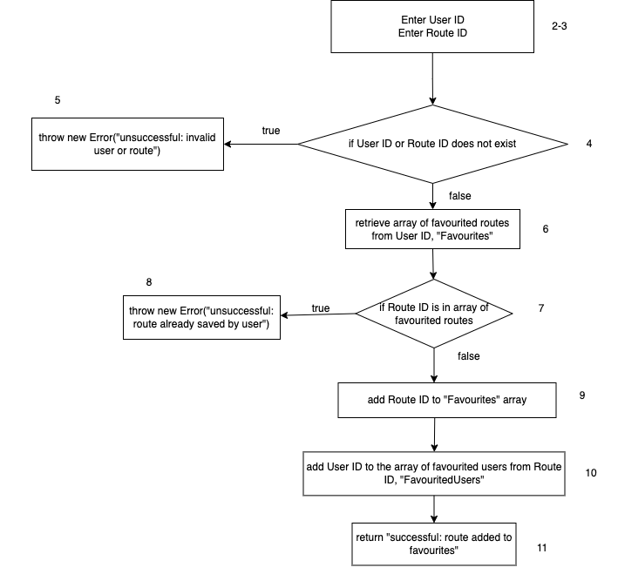
Whitebox Testing for favouriteRoute()
2 Decision points (Red)
3 Basis Paths (Blue)
3 Basis Paths:
Valid User ID, Route ID & Route ID not in “Favourites” array
Either User ID or Route ID is invalid
Valid User ID, Route ID & Route ID is already in “Favourites” array
Notes:
Next, we carried out whitebox testing for the favourite route function
For this function, it is important to determine if the user id and route id exists, as well as whether the route has already been added to the array of favourite routes.
Hence, as seen from the control flow, there 2 decision points given by the red boxes, and 3 basis paths shown in blue boxes.

Slide 15
Testing for favouriteRoute()
 | User ID | Route ID | Expected Output | Actual Output
1 | test | 3TbKc61tF5rFMoY1Wq1g | Successful: route added to favourites | Successful: route added to favourites
2a | test | 123 | Unsuccessful: invalid user or routes | Unsuccessful: invalid user or routes
2b | user | 3TbKc61tF5rFMoY1Wq1g | Unsuccessful: invalid user or routes | Unsuccessful: invalid user or routes
3 | test | 8EOn7GNDSXORNQXBvDfQ | Unsuccessful: route already saved by user | Unsuccessful: route already saved by user
Notes:
This slide shows the list of inputs and outputs corresponding to the 3 flows mentioned earlier

Slide 16
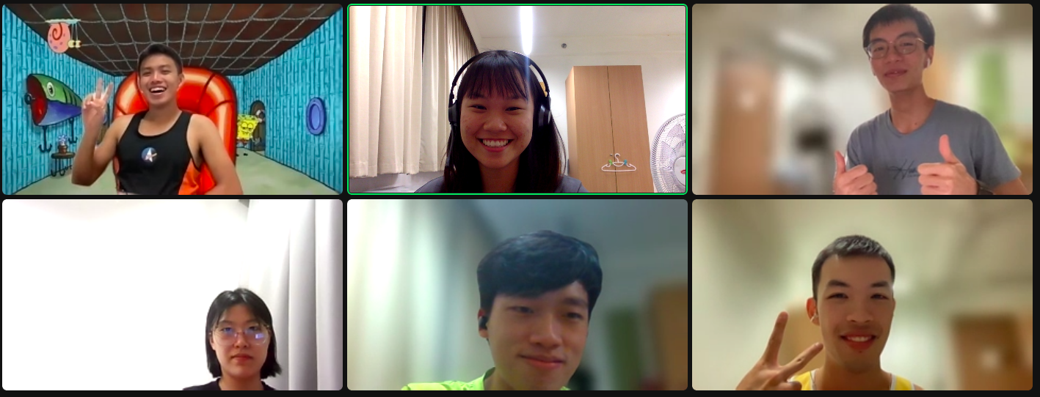
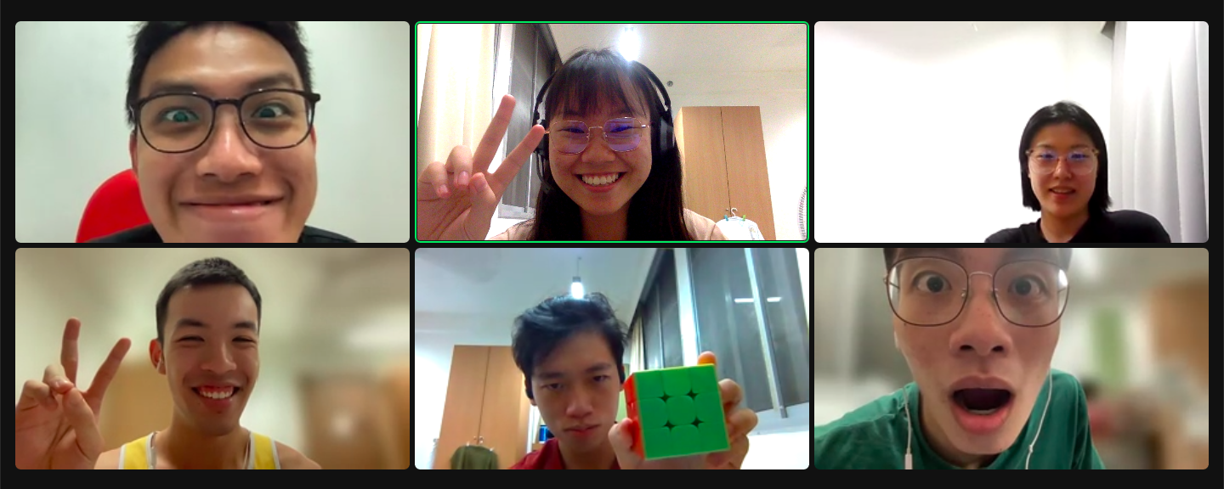
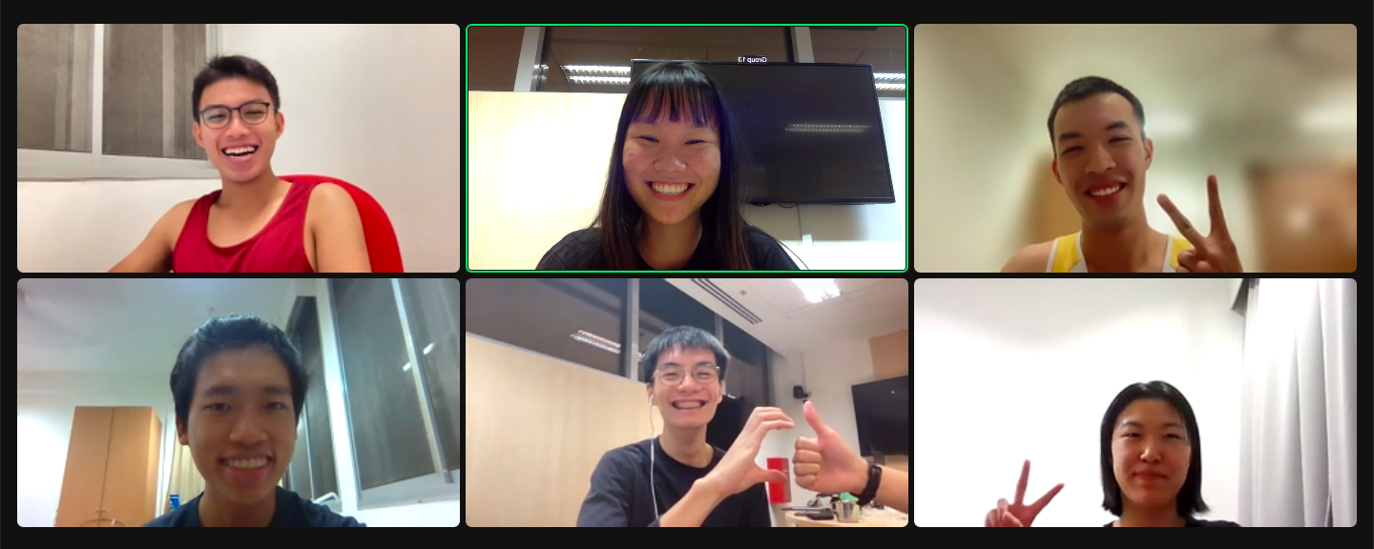
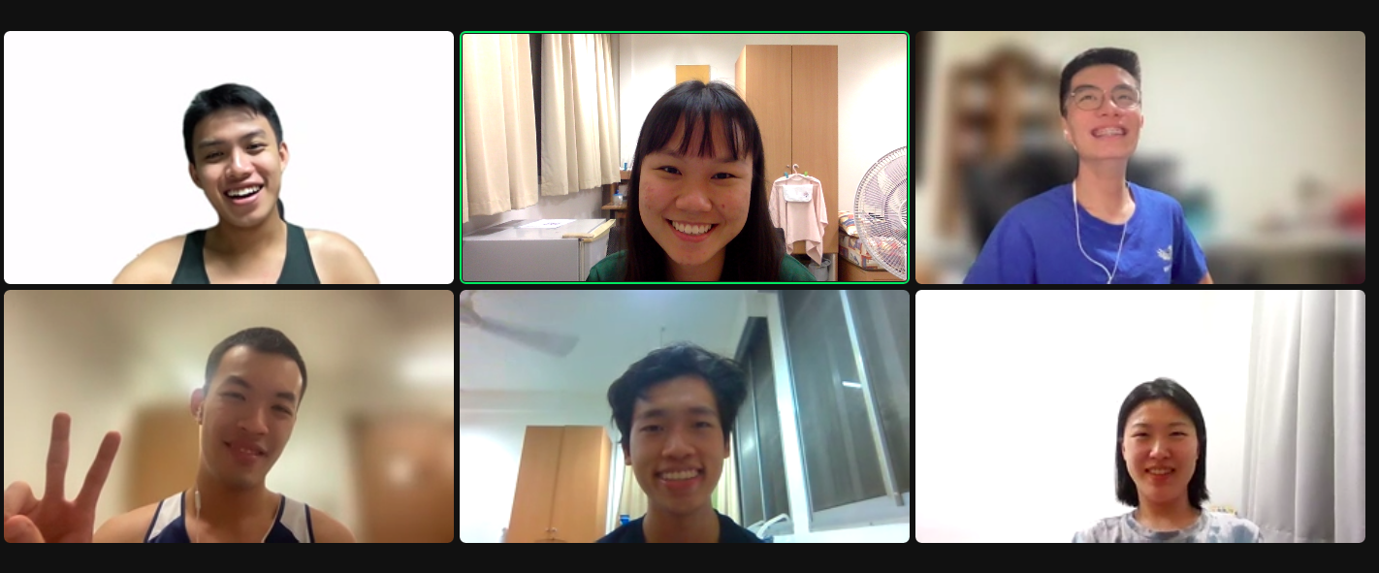
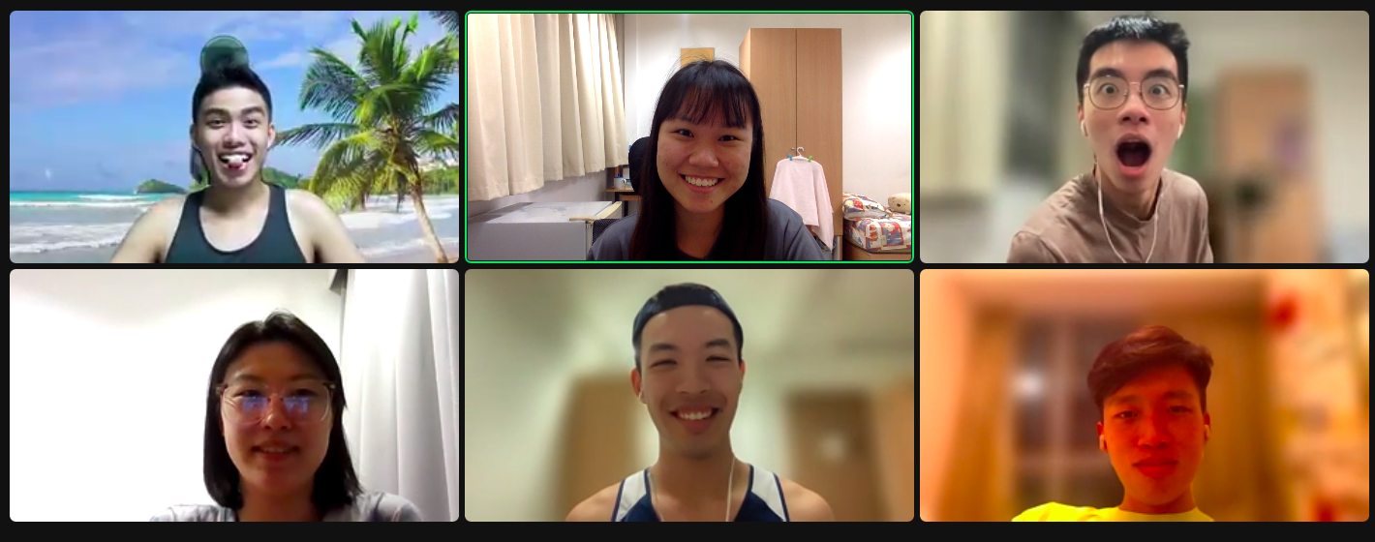
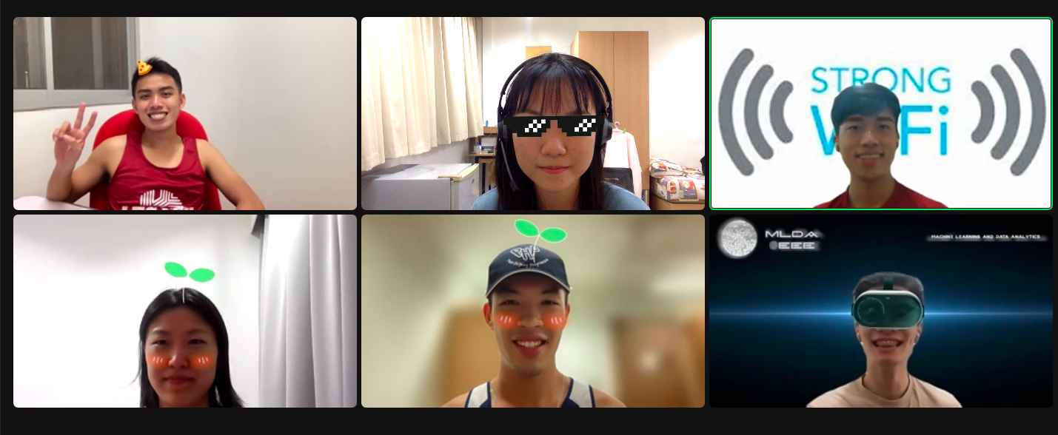
Good software engineering practice: weekly scrum meetings

Slide 17
Thank You!

